Slide 1

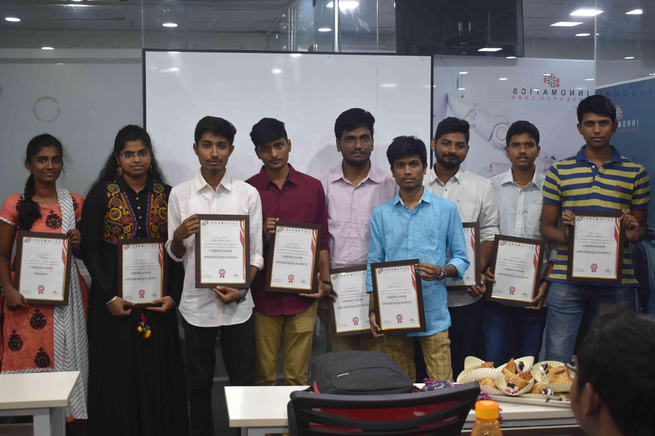
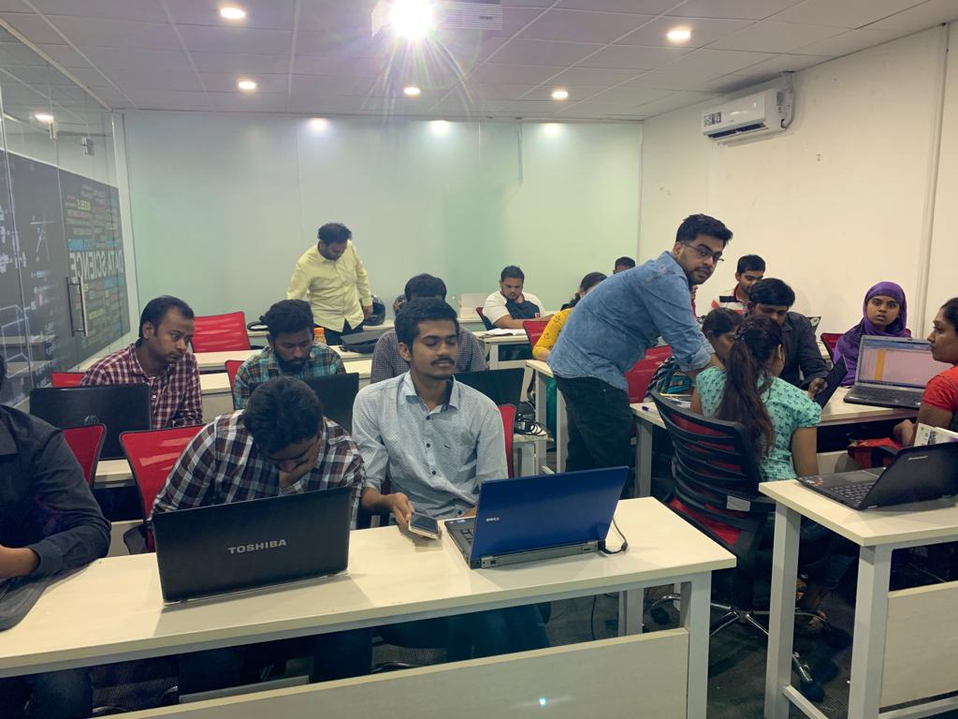

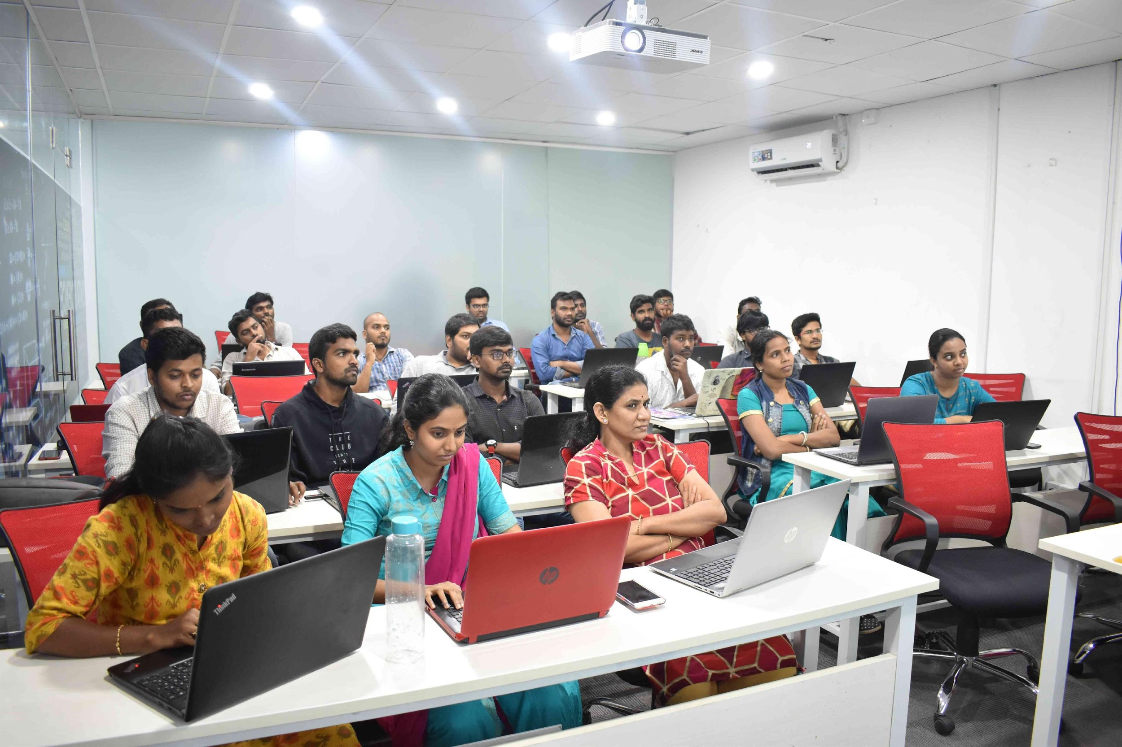
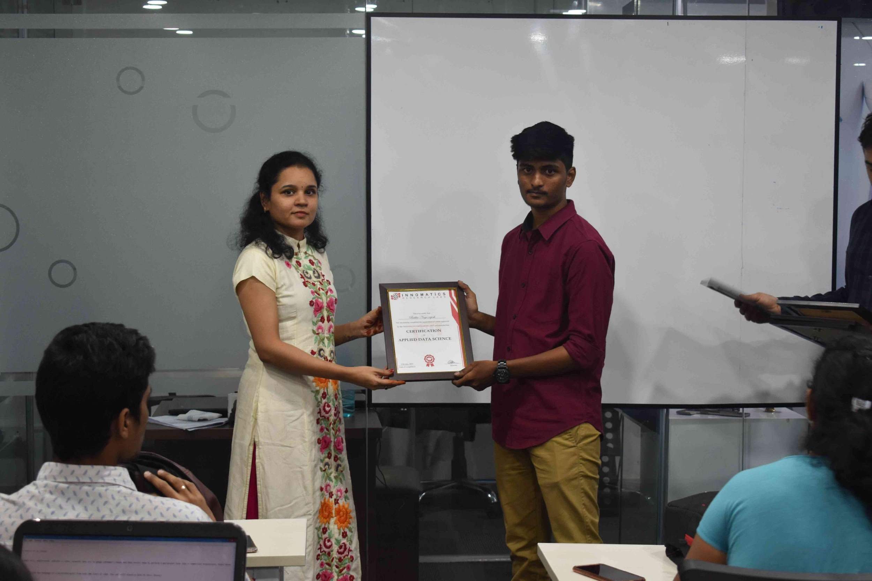
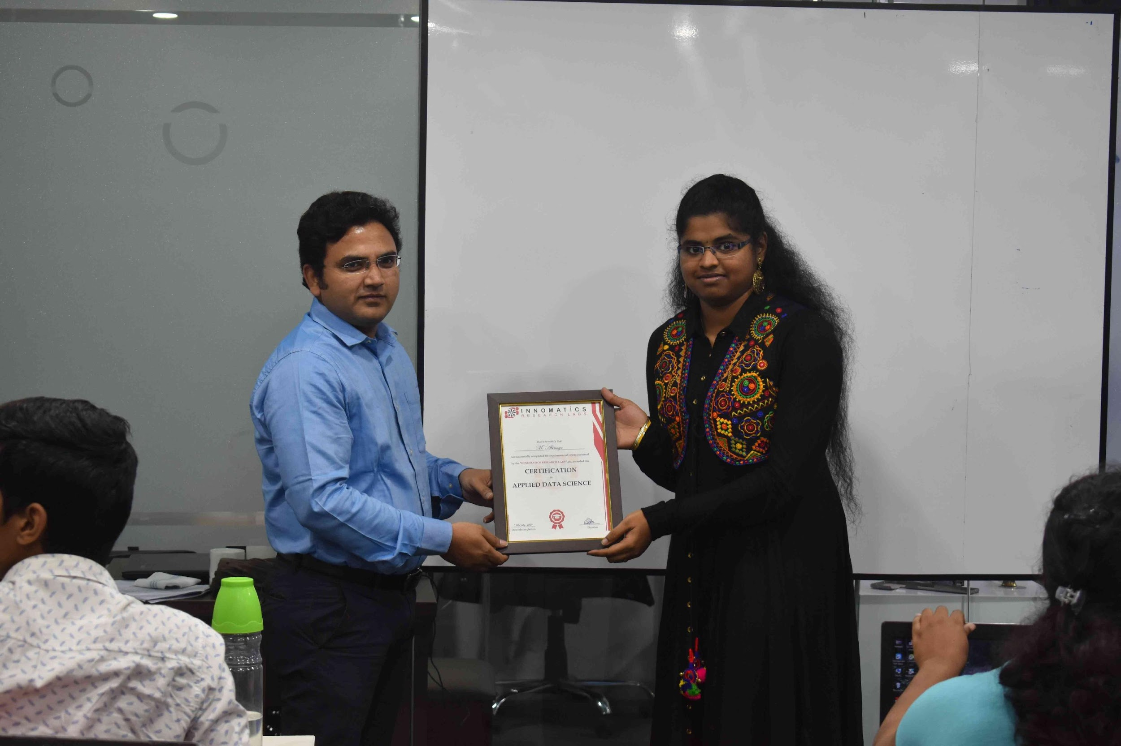

Slide 2

Cars 24 company analysis on cars for sale
B. Naga Mohan

Slide 3
About me
B-tech, Mechanical Engineering
I am interested in AI, ML, DL from my 4th year of engineering onwards. My passion in this area is not due to the high salary packages the DS people get and its also not due to because of booming technology. However, my interest is because, this technology can solve the problems of day to day life in every sector like Agriculture, Medical, Manufacturing and what not. Some of the applications which caught my interest are self driving cars, Prediction of heart attacks by using smart watches etc. Due to these reasons why I am learning Data Science.
One year experience as SQL and Power Bi developer

Slide 4
Agenda:
Business Problem
Objective of the Project
Web Scraping – Details (Websites, Processor I followed)
Summary of the Data
Data Cleaning
Data Manipulation
Univariate Analysis
BiVariate Analysis
Key Business Question
Conclusion (Key finding overall)
Q&A Slide
Your Experience of the Web Scraping – Data Analysis Project.

Slide 5
Business Problem:
Cars24 is an online ecommerce store for second handle cars.
Every customer who is willing to buy cars has specific requirements. They have an idea of what company, cost, fuel type, mileage, owner type etc.
To fulfill these requirements, some sort of Data analysis and filtering's are needed. So the user can buy the car within minutes as per his requirements rather than seeing the thousands of cars.
Another problem is employees who are working in cars24 should know what type of cars mostly coming for sale. So they can use those cars to attract more customers.

Slide 6
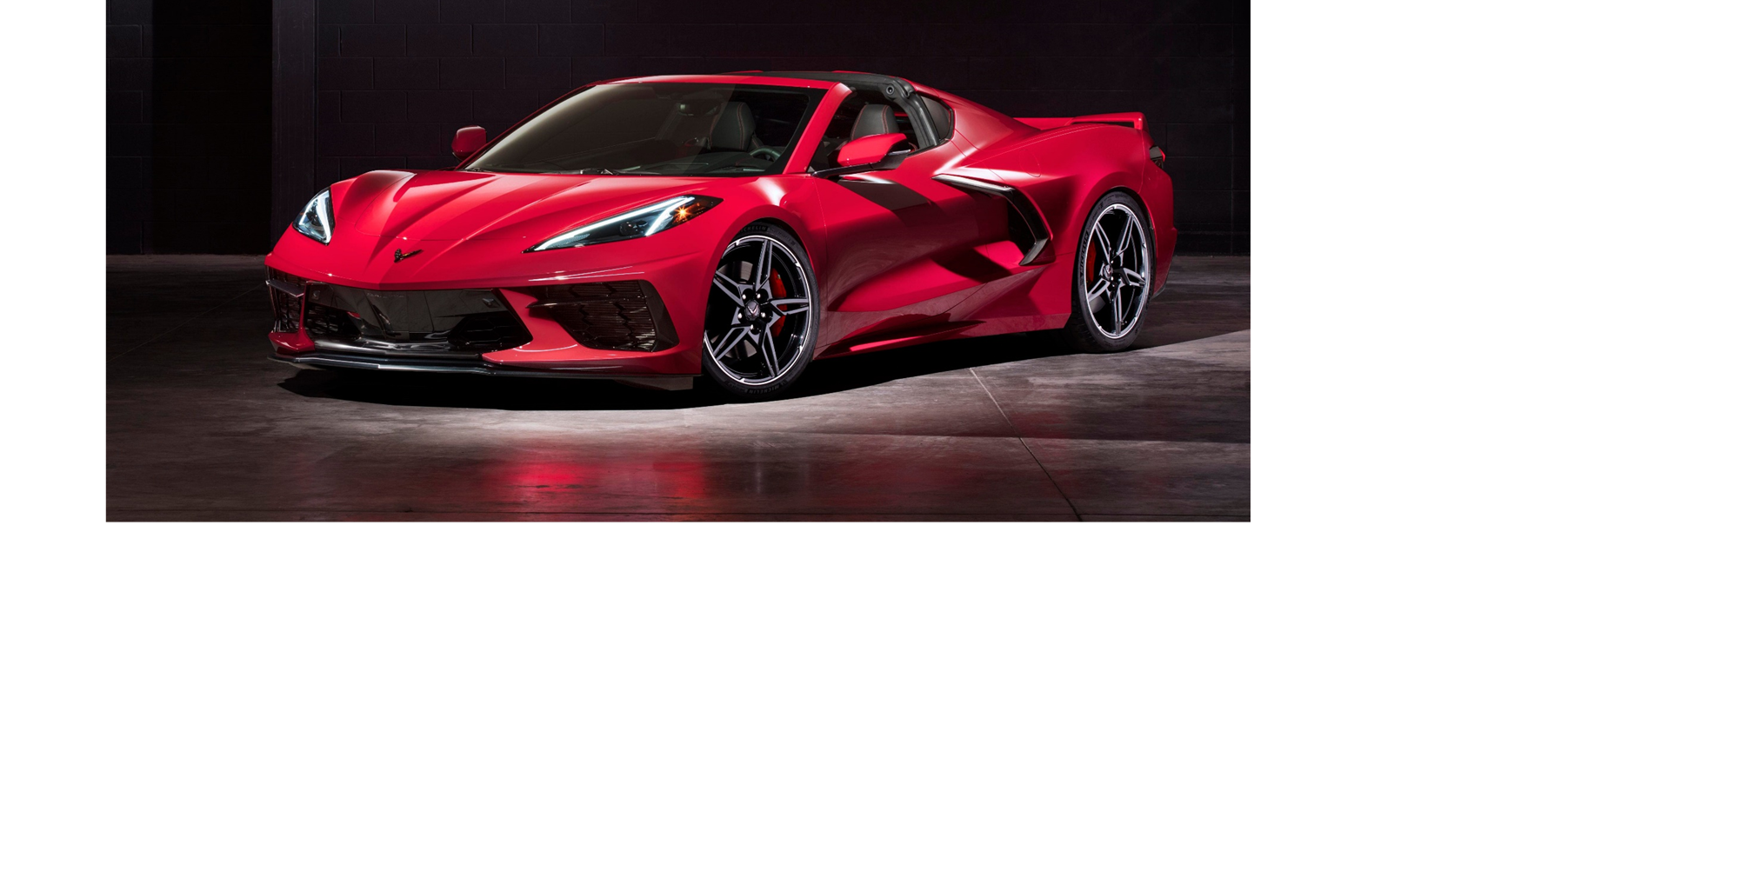
Objective of the project
To ease the process of selection of the cars and to select suitable car out of filtered dataset.
To convert the data of multiple pages in website to one table and use of Visualizations to pick the car, because people can easily understand if they have some graphs and colors in it rather than raw data.

Slide 7
Web scrapping:
Web scraping is an automatic method to obtain large amounts of data from websites. Most of this data is unstructured data in an HTML format which is then converted into structured data in a spreadsheet or a database so that it can be used in various applications.
Cars24 is the website taken to scrap the data.
The tool used to extract data is “Beautiful soup”.
Cars 24
website
Beautiful Soup
Extraction of data for only the cars which are in sale
Extracted data stores in different lists

Slide 8
Summary of the data:
The data scrapped from the website is
1. City name
2. Company and version of the car
3. Total price
4. Price per month
5. Fuel type
6. Owner type
7. Mode of transmission etc..

Slide 9
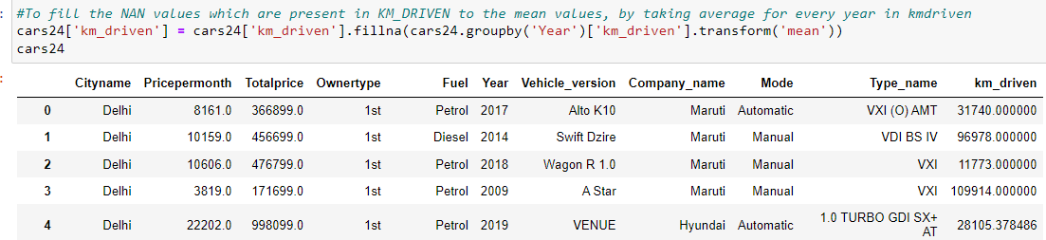
Data Cleaning:
For cleaning the data the tool used was Pandas, which is suitable for large set of datasets.
Some NAN rows were removed, because it is common for all the columns.
Some numerical column NAN values were replaced with mean and categorical column NANs replaced with highest frequency text in that column.
Some unnecessary data were removed from the columns like Pricepermonth, Owner type.
Applied some regular expressions and string methods to clean the data

Slide 10
Data Manipulation:
Converted every list into data frame
Some of the unnecessary columns were dropped from data frame like Payment, Page number.
Some columns divided into two to three columns and some of them were renamed.
Some of the columns datatypes were changed according to requirement like int to float etc
After Data cleaning and Data manipulation the file is stored as an xlsx file.
Below block chart represents both cleaning & manipulation:

Slide 11
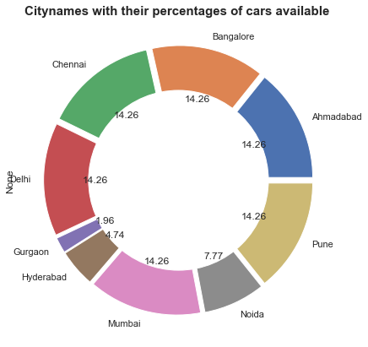
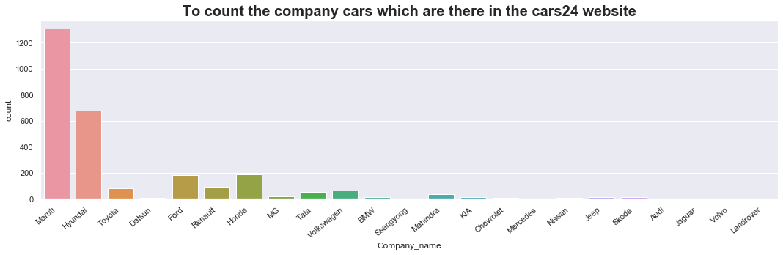
Univariate Analysis:
Analysis with only one variable is called Univariate analysis.
Some of the univariate plots are:

Slide 12
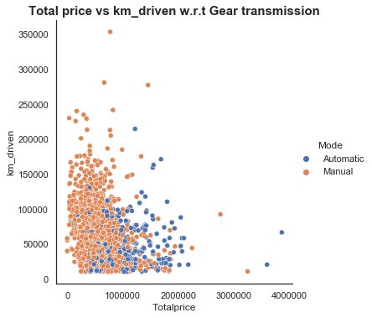
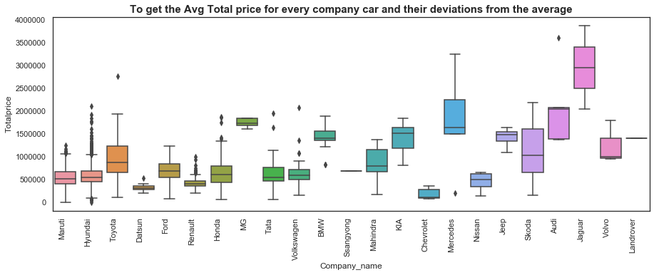
Bivariate Analysis:
Analysis with two variables is called Bivariate analysis.
Some of the Bivariate plots are:

Slide 13
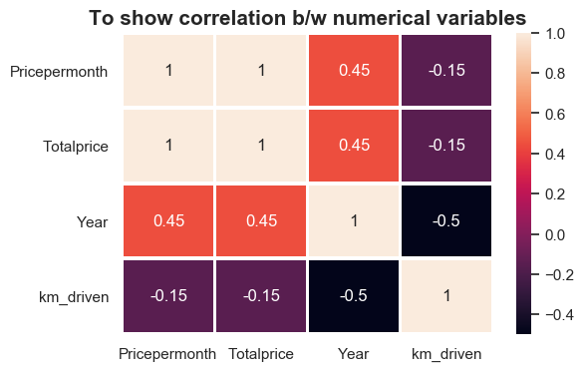
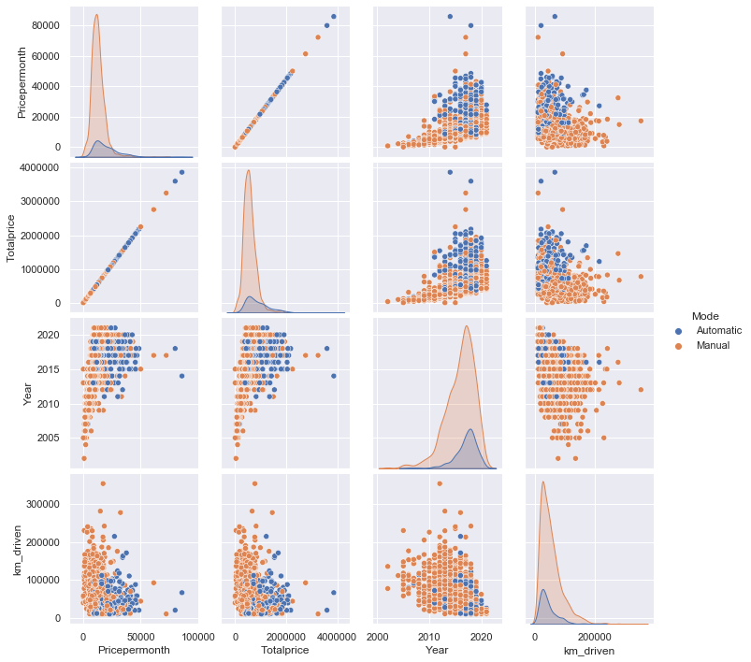
Multivariate Analysis:
Analysis with more than two variables is called Multi variate analysis.
Some of the Multivariate plots are:

Slide 14
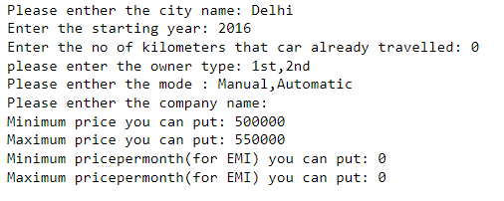
Key Business Question:
. How to make the process of selection of the car easy for the customer as per his requirements.

Slide 15
Conclusions:
"Maruti" company cars are high in number for sale.
70% of cars coming for sale is of 1st owner type,
The maximum price company cars for sale are Volvo and Volkswegan.
Manual cars 80% higher than automatic cars.
The car prices will be different for different cities depends on car owner type, year of purchase, city average costs.
To get good mileage people will prefer Diesel/CNG cars than petrol cars.
The 90 % cars coming for sale are in between 0 to 10000 km driven.
Petrol cars are more than Diesel/CNG cars.
The price per month is around 0 to 20000/- and Total price is 2 to 30 lakhs, for almost all of the cars.
90 % of the cars year of purchase is in between 2010-2020.
These are some of the points to consider based on the dataset from cars24 website

Slide 16

Any Queries

Slide 17
My Experience in web scraping
First & fore most , I love doing this project, learned many more things like how to scrap the large amounts of data from the websites, how to clean the raw data and to make best use of it, by providing some graphs.
Even though, I faced so many challenges in the process, I tried to clarify all my doubts from the mentors/googling.
I have also learned the customers mindset, ie. how/why/what they buy the things.
This project given me confidence and immense satisfaction.

Slide 18

THANK YOU

